Slide 1
ML1030 capstone project
Michael Vasiliou
Notes:
good morning and welcome to my ML 1030 progress update for my capstone project on NLP interpret ability

Slide 2


Project Overview
Machine Learning model interpretability in a clinical setting
Natural Language Processing (NLP) interpretability
Primary dataset MIMIC-III
The output of the proposed system is an interpretable Knowledge Base, which can link the pattern groups, discovered characteristics of records, and patients’ records together to shows “what” (disease), “who/where” (tracking patient records back) and “why” (discovered patterns) to interpret clinical notes for better clinical decision making.
- Interpretability on Clinical Analysis from Pattern Disentanglement Insight
Notes:
The overall research project goal is to improve the ability and acceptance of Machine Learning in clinical decision making. The research project focuses on model interpretability across multiple models and datasets including the IMDB movie review, and the MIMIC 3 clinical dataset.
Through analyzing the disparate datasets, including the health care records and discharge summaries of 40,000 patients and comparing interpretability across multiple machine learning models, the project aims to improve clinician trust, model interpretability, and uptake within a clinical setting.
In something as important as healthcare it’s critical for the end users to understanding the reasons why a machine learning model is making it’s predictions.

Slide 3

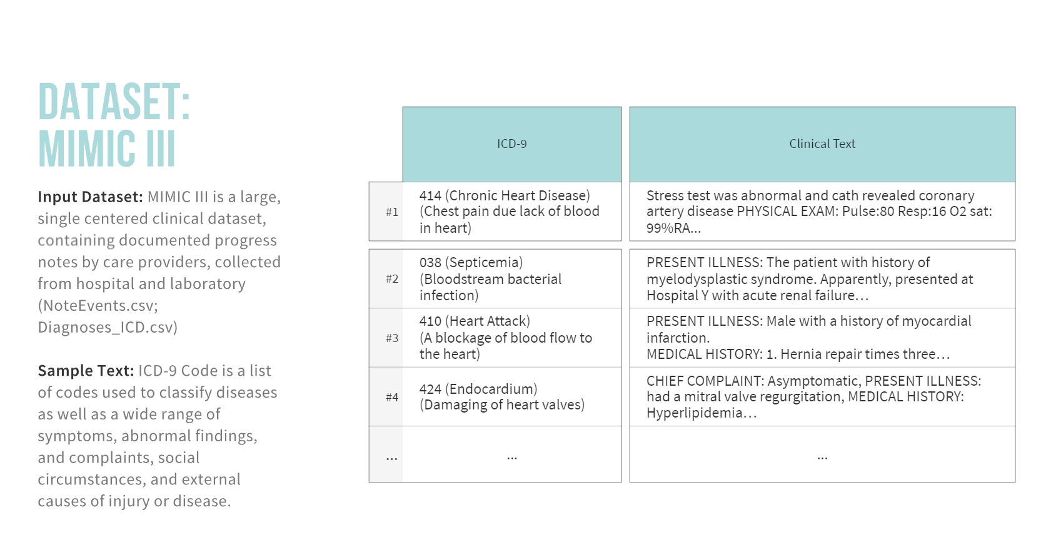
Notes:
Lots of datasets – main one for clinical

Slide 4
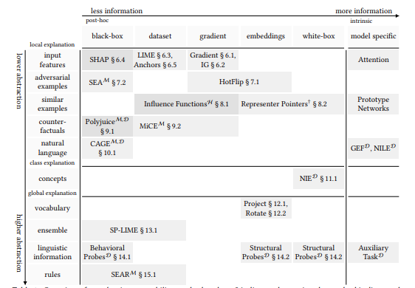
How it started – Model interpretability
SHAP
LIME
Transformers-Interpret
Natural Indirect Effect (NIE)
<more>
Source: Post-hoc Interpretability for Neural NLP: A Survey by Madsen, Reddy, Chandar
Notes:
There are a number of interpretability options and the project team is looking to implement as many as possible beginning with SHAP, LIME, Transformers-interpret, and Natural Indirect Effect (NIE). Other interpretability options will be added in future iterations of the research project.

Slide 5
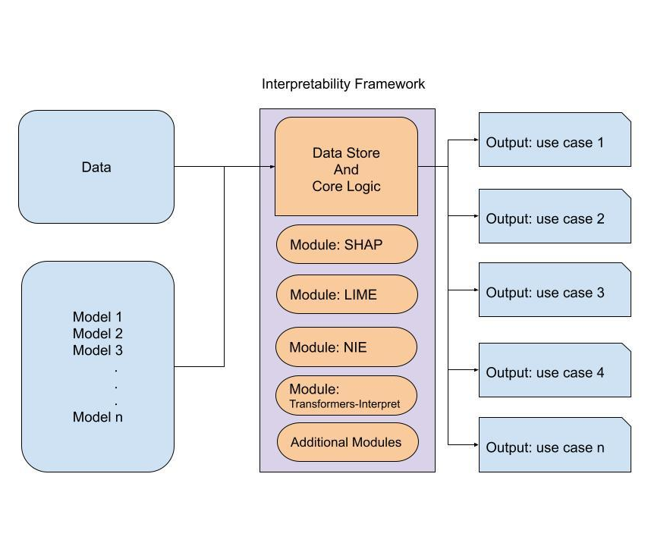
Interpretability Framework
Key Factors
Multiple models
Multiple data sets
Project longevity
Multiple interpretability frameworks
Multiple team members
Benefits:
Consistency
Repeatability
Ease of use
Longevity/Expansion
Notes:
Started here

Slide 6
How it’s going - Transition to pipeline
Consistency
Focus on results not coding
Different models
Different datasets
Multiple researchers
Notes:
Multiple researchers with different skillsets

Slide 7
Design requirements
Project Requirements
Transfer of Knowledge
Maintainability
Scientific Requirements
Repeatability
Consistency
Technical Requirements
Ease of use
Comparability
Documentation
Ease of reporting
Low implementation overhead
Multiple platforms
Multiple models
Interpretability
Model reporting
Model comparison
Notes:
Insert design requirements
-project/scientific/technical

Slide 8
Pipeline Conceptual overview
Preprocessing
*Cleaning
Feature Engineering
*TF-IDF
Modeling
*Split Train/Test
*Stopwords
Null
*Custom Stopwords
Spell Check
Stem/Lemmatize
Post-Hoc Interpretability
Text Length
Parts of Speech
*Train model
*Predict
Label Encoding
*Random Forest
*XGBoost
CNN
PDD
Kmeans
*Feature Importance
Glove
Word2Vec
BERT
Model Reporting
*Accuracy
*Precision
*Recall
*F1
*Cohen-Kappa
*ROC/AUC
*Learning Curve
*Confusion Matrix
*Precision/Recall Curve
*LIME
*SHAP
Natural Indirect Effect (NIE)
Transformers-Interpret
Knowledge Transfer
*Feature implemented
Notes:
With knowledge transfer as a key foundational component, the next steps in this project will be to integrate the existing trained models, architect the Data storage to match the standardized project format, and add as many interpretability options as possible to address the researchers needs and use cases.
There is insufficient time to include all the interpretability options. The goal is to lay the pipeline foundation with some interpretability options in order to allow the project team to enhance for continued future success.

Slide 9
Framework conceptual overview
Experiment Manager
Data Manager ->orig. data ->working data
Data Processing Parameters
Experiment 1 -> model -> results -> predictions
Experiment 2 -> model -> results -> predictions
Experiment 3 -> model -> results -> predictions
Experiment n -> model -> results -> predictions

Slide 10
Data Manager
Step 1 Assemble
Step 2 Create
Step 3 Process
Original Data
Data Package
Data Package
Processing Parameters
Original Data
Data Package
Original Data
Processing Parameters
Working Data
Processing Parameters
Clean
Stop word
Stem
Encode
Split Train/Test

Slide 11
Experiment Manager
Step 1 Create
Step 2 Add
Step 3 Process
Data Package
Experiment Manager
Experiment Manager
Experiment Manager
Data Package
Data Package (Processed)
Model
Experiment 1
Experiment 2
Experiment 1
Experiment 2
Trained Model
Trained Model
Model
Model
Model Outputs
Model Outputs
Notes:
Model Artifacts
-Prediction results
-Learning Curves

Slide 12

Use Case – Sharing data package
Dataset 1
Processing Parameters
Dataset 2
Dataset 3
Notes:
Use the same processing parameters amongst different datasets

Slide 13


Use Case – Sharing processing parameters
Data Package
Manual
Processing
Notes:
Manual intervention – share data package amongst other researchers
Pycaret – bag of words, no manual intervention possible

Slide 14


Walkthrough

Slide 15
Conclusion and next steps
Github repo
Add outstanding features
Testing/Documentation
Sample notebooks

Slide 16


